Slide 1
CCB Act 166 Sec. 15a Working Group
August 21, 2024

Slide 2
Overview
Review Act 166 (2024), Sec. 15a
History of Cannabis Policy
Market Overview
Questions

Slide 3
Review Act 166 (2024), Sec. 15a

Slide 4
Review Act 166 (2024), Sec. 15a
CANNABIS BUSINESS DEVELOPMENT FUND; CANNABIS SOCIAL EQUITY WORKING GROUP
The Cannabis Control Board shall work in consultation with the Vermont Housing and Conservation Board, the Vermont Land Access and Opportunity Board, the Vermont Racial Justice Alliance, the Office of Racial Equity, and the Agency of Commerce and Community Development for purpose of making recommendations to the General Assembly regarding a percentage of cannabis excise tax monies that should be appropriated to the Cannabis Business Development Fund for uses as provided pursuant to 7 V.S.A. § 987. The Cannabis Control Board shall incorporate the recommendations into the Cannabis Social Equity Programs report required pursuant to 7 V.S.A. § 989.
Notes:
Legislature set a goal to move as much of the illicit market into the regulated market as possible that meant
legacy/small growers were prioritized - Also CCB was allowed to reduce some the regulatory burden for small cultivators
Small cultivators are considered farming by statute – which is important from a land use planning perspective in Vermont
And, in consideration of the environmental impact and the agricultural season in Vermont – among the small growers, outdoor cultivation licenses were prioritized
Results in a market structure in which the majority of cannabis in Vermont (at the moment) is
grown outdoor – roughly 70% of our cultivators are outdoor
Roughly 30% of our outdoor cultivators are Tier 1 small cultivators (upto 1000sqft or 125 plants)
Is likely that the majority of cannabis flower will be to be harvested between September and October, and just one harvest this year

Slide 5
Review Act 166 (2024), Sec. 15a
§ 987. CANNABIS BUSINESS DEVELOPMENT FUND
There is established the Cannabis Business Development Fund, which shall be managed in accordance with 32 V.S.A. chapter 7, subchapter 5.
The Fund shall comprise:
(1) a one-time contribution of $50,000.00 per integrated license to be made on or before October 15, 2022; and
(2) monies allocated to the fund by the General Assembly.
(c) The Fund shall be used for the following purposes:
(1) to provide low-interest rate loans and grants to social equity applicants to pay for ordinary and necessary expenses to start and operate a licensed cannabis establishment;
(2) to pay for outreach that may be provided or targeted to attract and support social equity applicants;
(3) to assist with job training and technical assistance for social equity applicants; and
(4) to pay for necessary costs incurred in administering the Fund
Notes:
Legislature set a goal to move as much of the illicit market into the regulated market as possible that meant
legacy/small growers were prioritized - Also CCB was allowed to reduce some the regulatory burden for small cultivators
Small cultivators are considered farming by statute – which is important from a land use planning perspective in Vermont
And, in consideration of the environmental impact and the agricultural season in Vermont – among the small growers, outdoor cultivation licenses were prioritized
Results in a market structure in which the majority of cannabis in Vermont (at the moment) is
grown outdoor – roughly 70% of our cultivators are outdoor
Roughly 30% of our outdoor cultivators are Tier 1 small cultivators (upto 1000sqft or 125 plants)
Is likely that the majority of cannabis flower will be to be harvested between September and October, and just one harvest this year

Slide 6
Review Act 166 (2024), Sec. 15a
§ 989. Reporting
The Cannabis Control Board, in consultation with the Advisory Committee, the Agency of Commerce and Community Development, and the Executive Director of Racial Equity, shall report to the General Assembly on or before January 15, 2023 and biennially thereafter regarding the implementation and application of this chapter, including data on the number of applicants, the number of recipients, the number and amounts of loans and grants, and the identification of continuing barriers to accessing the cannabis market for social equity applicants. This information shall be presented in a manner that can be quantified and tracked over time.
Notes:
Legislature set a goal to move as much of the illicit market into the regulated market as possible that meant
legacy/small growers were prioritized - Also CCB was allowed to reduce some the regulatory burden for small cultivators
Small cultivators are considered farming by statute – which is important from a land use planning perspective in Vermont
And, in consideration of the environmental impact and the agricultural season in Vermont – among the small growers, outdoor cultivation licenses were prioritized
Results in a market structure in which the majority of cannabis in Vermont (at the moment) is
grown outdoor – roughly 70% of our cultivators are outdoor
Roughly 30% of our outdoor cultivators are Tier 1 small cultivators (upto 1000sqft or 125 plants)
Is likely that the majority of cannabis flower will be to be harvested between September and October, and just one harvest this year

Slide 7
Review Act 166 (2024), Sec. 15a
Act 164 (2020)
Sec. 19. SUBSTANCE MISUSE PREVENTION FUNDING
Thirty percent of the revenues raised by the cannabis excise tax imposed by 32 V.S.A. § 7901, not to exceed $10,000,000.00 per fiscal year, shall be used for the purpose of funding substance misuse prevention programming.
Notes:
Legislature set a goal to move as much of the illicit market into the regulated market as possible that meant
legacy/small growers were prioritized - Also CCB was allowed to reduce some the regulatory burden for small cultivators
Small cultivators are considered farming by statute – which is important from a land use planning perspective in Vermont
And, in consideration of the environmental impact and the agricultural season in Vermont – among the small growers, outdoor cultivation licenses were prioritized
Results in a market structure in which the majority of cannabis in Vermont (at the moment) is
grown outdoor – roughly 70% of our cultivators are outdoor
Roughly 30% of our outdoor cultivators are Tier 1 small cultivators (upto 1000sqft or 125 plants)
Is likely that the majority of cannabis flower will be to be harvested between September and October, and just one harvest this year

Slide 8
History of Cannabis Policy

Slide 9
History of Cannabis Policy – United States
The Controlled Substances Act (CSA)
Schedule I: high potential for abuse with no currently accepted medical use in treatment in the United States. Examples: heroin, lysergic acid diethylamide (LSD), marijuana (cannabis), 3,4-methylenedioxymethamphetamine (ecstasy), methaqualone, and peyote.
Schedule II: high potential for abuse, with use potentially leading to severe psychological or physical dependence. Examples: combination products with less than 15 milligrams of hydrocodone per dosage unit (Vicodin), cocaine, methamphetamine, methadone, hydromorphone (Dilaudid), meperidine (Demerol), oxycodone (OxyContin), fentanyl, Dexedrine, Adderall, and Ritalin
Schedule III: moderate to low potential for physical and psychological dependence. Examples: products containing less than 90 milligrams of codeine per dosage unit (Tylenol with codeine), ketamine, anabolic steroids, testosterone
Schedule IV: low potential for abuse and low risk of dependence. Examples: Xanax, Soma, Darvon, Darvocet, Valium, Ativan, Talwin, Ambien, Tramadol
Schedule V: lower potential for abuse than Schedule IV and consist of preparations containing limited quantities of certain narcotics. Examples: cough preparations with less than 200 milligrams of codeine or per 100 milliliters (Robitussin AC), Lomotil, Motofen, Lyrica, Parepectolin
Notes:
Legislature set a goal to move as much of the illicit market into the regulated market as possible that meant
legacy/small growers were prioritized - Also CCB was allowed to reduce some the regulatory burden for small cultivators
Small cultivators are considered farming by statute – which is important from a land use planning perspective in Vermont
And, in consideration of the environmental impact and the agricultural season in Vermont – among the small growers, outdoor cultivation licenses were prioritized
Results in a market structure in which the majority of cannabis in Vermont (at the moment) is
grown outdoor – roughly 70% of our cultivators are outdoor
Roughly 30% of our outdoor cultivators are Tier 1 small cultivators (upto 1000sqft or 125 plants)
Is likely that the majority of cannabis flower will be to be harvested between September and October, and just one harvest this year

Slide 10
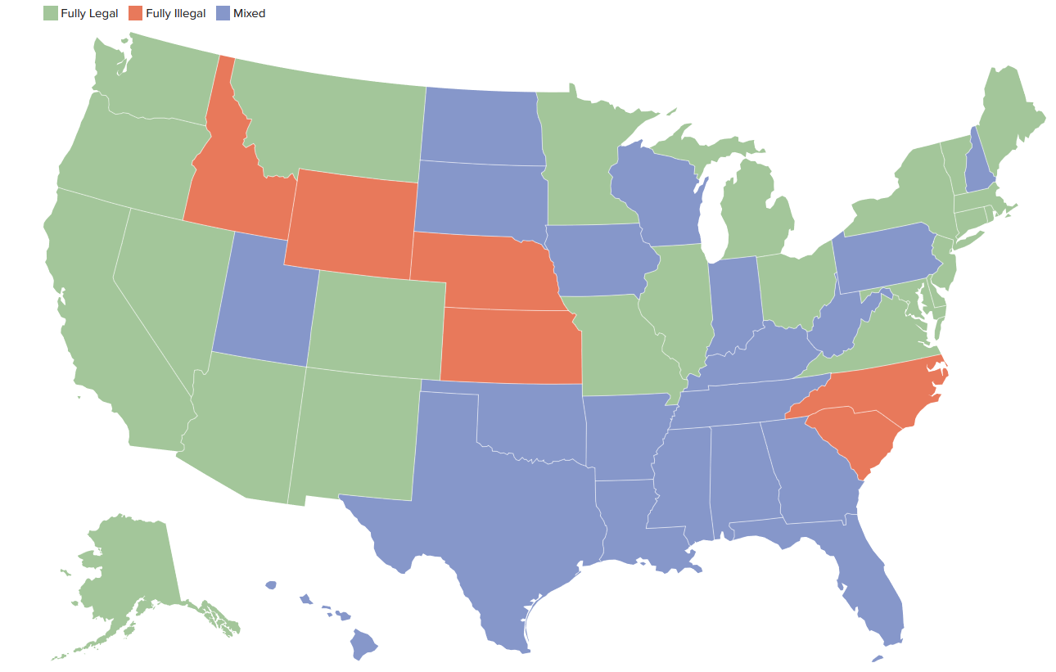
History of Cannabis Policy – United States
Notes:
Legislature set a goal to move as much of the illicit market into the regulated market as possible that meant
legacy/small growers were prioritized - Also CCB was allowed to reduce some the regulatory burden for small cultivators
Small cultivators are considered farming by statute – which is important from a land use planning perspective in Vermont
And, in consideration of the environmental impact and the agricultural season in Vermont – among the small growers, outdoor cultivation licenses were prioritized
Results in a market structure in which the majority of cannabis in Vermont (at the moment) is
grown outdoor – roughly 70% of our cultivators are outdoor
Roughly 30% of our outdoor cultivators are Tier 1 small cultivators (upto 1000sqft or 125 plants)
Is likely that the majority of cannabis flower will be to be harvested between September and October, and just one harvest this year

Slide 11
History of Cannabis Policy – Vermont
2004: Legislature legalizes medical cannabis
2011: Legislature permits the establishment of medical-marijuana dispensaries
2013: Legislature decriminalizes possession of up to 1 oz. of cannabis for personal use
2017: Governor Scott establishes a Marijuana Advisory Commission to consider commercial cannabis
2018: Vermont legalizes cannabis (home grow / possession)
2020: Legislature legalizes commercial adult-use cannabis sales and creates the Cannabis Control Board (Act 164)
2022: First legal commercial sales of cannabis
Notes:
Legislature set a goal to move as much of the illicit market into the regulated market as possible that meant
legacy/small growers were prioritized - Also CCB was allowed to reduce some the regulatory burden for small cultivators
Small cultivators are considered farming by statute – which is important from a land use planning perspective in Vermont
And, in consideration of the environmental impact and the agricultural season in Vermont – among the small growers, outdoor cultivation licenses were prioritized
Results in a market structure in which the majority of cannabis in Vermont (at the moment) is
grown outdoor – roughly 70% of our cultivators are outdoor
Roughly 30% of our outdoor cultivators are Tier 1 small cultivators (upto 1000sqft or 125 plants)
Is likely that the majority of cannabis flower will be to be harvested between September and October, and just one harvest this year

Slide 12
History of Cannabis Policy – Vermont
2013: Cole Memoranda
The distribution of marijuana to minors;
Revenue from going to criminal enterprises, gangs and cartels;
Diversion of marijuana from states where it is legal to states where it is illegal;
Use of state-authorized marijuana activity as a cover for other illegal drugs or activity;
Violence and the use of firearms;
Drugged driving or other adverse public health consequences;
The use of public lands for marijuana production; and
Marijuana possession or use on federal property.
2014: FinCEN Memo
2014: Rohrabacher–Farr amendment “None of the funds made available in this Act to the Department of Justice may be used…to prevent such States from implementing their own State laws that authorize the use, distribution, possession, or cultivation of medical marijuana.”
2018: Cole Memo rescinded
2024: Department of Justice files rule amendment to re-classify “marijuana” under Schedule 3
Notes:
Legislature set a goal to move as much of the illicit market into the regulated market as possible that meant
legacy/small growers were prioritized - Also CCB was allowed to reduce some the regulatory burden for small cultivators
Small cultivators are considered farming by statute – which is important from a land use planning perspective in Vermont
And, in consideration of the environmental impact and the agricultural season in Vermont – among the small growers, outdoor cultivation licenses were prioritized
Results in a market structure in which the majority of cannabis in Vermont (at the moment) is
grown outdoor – roughly 70% of our cultivators are outdoor
Roughly 30% of our outdoor cultivators are Tier 1 small cultivators (upto 1000sqft or 125 plants)
Is likely that the majority of cannabis flower will be to be harvested between September and October, and just one harvest this year

Slide 13
Market Overview

Slide 14
Introduction
The Cannabis Control Board (CCB) is a three-member independent executive branch agency that was established through Act 164 of 2020 for the purpose of safely, equitably, and effectively implementing and administering the laws and rules regulating adult- and medical-use cannabis (marijuana) in Vermont.
James Pepper (Chair)
Kyle Harris
Julie Hulburd
Notes:
Legislature set a goal to move as much of the illicit market into the regulated market as possible that meant
legacy/small growers were prioritized - Also CCB was allowed to reduce some the regulatory burden for small cultivators
Small cultivators are considered farming by statute – which is important from a land use planning perspective in Vermont
And, in consideration of the environmental impact and the agricultural season in Vermont – among the small growers, outdoor cultivation licenses were prioritized
Results in a market structure in which the majority of cannabis in Vermont (at the moment) is
grown outdoor – roughly 70% of our cultivators are outdoor
Roughly 30% of our outdoor cultivators are Tier 1 small cultivators (upto 1000sqft or 125 plants)
Is likely that the majority of cannabis flower will be to be harvested between September and October, and just one harvest this year

Slide 15
Introduction
185 Public Meetings
110 CCB Board Meetings
75 Advisory Committee / Subcommittees
2 Banking Roundtables
3 Hemp Roundtables
6 Rule or guidance review and discussions
5 business advice and best practices
Topics include insurance, starting a new business, tax compliance, and fire and workplace safety
9 Social Equity Town Halls and networking events
2 Municipal Roundtables
Open discussions on statutes and rules that impact municipalities and Local Cannabis Control Commissions
4 Q&A Sessions
Notes:
Legislature set a goal to move as much of the illicit market into the regulated market as possible that meant
legacy/small growers were prioritized - Also CCB was allowed to reduce some the regulatory burden for small cultivators
Small cultivators are considered farming by statute – which is important from a land use planning perspective in Vermont
And, in consideration of the environmental impact and the agricultural season in Vermont – among the small growers, outdoor cultivation licenses were prioritized
Results in a market structure in which the majority of cannabis in Vermont (at the moment) is
grown outdoor – roughly 70% of our cultivators are outdoor
Roughly 30% of our outdoor cultivators are Tier 1 small cultivators (upto 1000sqft or 125 plants)
Is likely that the majority of cannabis flower will be to be harvested between September and October, and just one harvest this year

Slide 16
Introduction
The Cannabis Control Board Team
Executive Team
Executive Director
Compliance Team
Interim Director
Licensing Team
Director
General Counsel
Patrick Crowley
Olga Fitch
Gabe Gilman
Education & Outreach Manager
Karen Schifferle
Finance Manager
(hiring)
Michael DiTomasso
Compliance Agents
Deputy Director
Medical Team
Denise McCarty
Lawrence "Chipper" Sullivan
Kimberly Lashua
Licensing Agents
Melissa Anderson
Deputy Director
Christine Motyka,
Medical Marijuana Program
Dominque Acilio
Isabel Senter
Duane Tomlin
Andy Chevrefils
Director of Operations
Kelsi Ager
Heather Munzberg-Edson
Preya Holland
Data Manager
Elizabeth Love
Janae Miller (Temp)
Nicole West
Notes:
Legislature set a goal to move as much of the illicit market into the regulated market as possible that meant
legacy/small growers were prioritized - Also CCB was allowed to reduce some the regulatory burden for small cultivators
Small cultivators are considered farming by statute – which is important from a land use planning perspective in Vermont
And, in consideration of the environmental impact and the agricultural season in Vermont – among the small growers, outdoor cultivation licenses were prioritized
Results in a market structure in which the majority of cannabis in Vermont (at the moment) is
grown outdoor – roughly 70% of our cultivators are outdoor
Roughly 30% of our outdoor cultivators are Tier 1 small cultivators (upto 1000sqft or 125 plants)
Is likely that the majority of cannabis flower will be to be harvested between September and October, and just one harvest this year

Slide 17
Market Structure
License Types
CULTIVATION
(OPEN APRIL ‘22)
MANUFACTURING
(OPEN JULY ‘22)
Cultivator licensees may grow cannabis plants, either outdoors or indoors.
Manufacturer licensees may produce cannabis products from cannabis plants, including edibles, oils, and other such products.
TESTING LAB
(OPEN APRIL ‘22)
Testing Laboratory licensees may test cannabis and cannabis products obtained from a licensed cannabis establishment, dispensary, or a member of the public.
INTEGRATED
(OPEN APRIL ‘22)
Integrated Licensees may engage in the activities of each of the other license types listed above, but these licenses are only available to "an applicant and its affiliates that hold a dispensary registration on April 1, 2022."
WHOLESALE
(OPEN JULY ‘22)
Wholesaler licensees may purchase cannabis and cannabis products from other licensees and sell them to licensees.
RETAIL
(OPEN SEPT ‘22)
Retailer licensees may sell cannabis and cannabis products to the general public. No other license type may sell to the general public.
7 V.S.A. § 904
7 V.S.A. § 909
7 V.S.A. § 906
7 V.S.A. § 905
7 V.S.A. § 907.
7 V.S.A. § 908
PROPOGATOR
(OPEN JULY ‘24)
Propagator may cultivate not more than 3500 square feet of cannabis clones, immature cannabis plants, or mature cannabis plants
7 V.S.A. § 904
Some license types have tiers with in them based on size or function of the operation.
Notes:
As a reminder, there are 6 license types the cultivation and manufacturing license types have tiers with in them based on size and complexity of the operation
All types and tiers are open EXCEPT tier 6 cultivation which is the largest tier. We will open that tier only if the market requires it.
Licenses mirror steps along the supply chain.
In Vermont an applicant can have only one of each type of license
Applicants can only have one license per location – which means chain operations are not allowed
But applicants can apply to stack or vertically integrate licenses – can only have one of each type
The cultivator and manufacturing licensees can have more than one licensee at a location, for example share growing space or manufacturing space – there are some restrictions on that in Rule 2
Cultivators can operate more than one licenses at a location but together they cannot cultivate more than the larges license type
There is one license type - the integrated license allows a license to do all of the things that each of the individual licenses can do under one license – these licenses are only available to those that held a dispensary license as of April 1. The purpose of this license was to have a path for the existing medical dispensaries enter the adult use market
Back in May we talked about all of the license types, today we will focus on retail.
As a reminder licensed retail cannabis establishments and the retail portion of an integrated license, are the only license type permitted to sell cannabis and cannabis products to the public.
all other license types may only sell or transfer within the supply chain.
Retail opened ahead of schedule to allow more time for applicants and the licensing team, retail is our most complex license type

Slide 18
Market Structure
Projected Market Size: FY24 – $108M (CCB) / $86M (JFO); FY25 – $197M (CCB) / $113M (JFO)
Projected Cannabis Demand: Approximately 1.5M sq. ft. / 34 acres total flowering canopy
• Utilized Vermont county and municipal level population projections from Vermont Center for Geographic Information.
• Overlayed state and sub-state past month and past year cannabis use frequency data from the federal National Survey on Drug Use and Health (NSDUH) administered by the Substance Abuse and Mental Health Services Administration.
• Analyzed seasonal tourism data from Vermont Agency of Commerce and Community Development to evaluate non-Vermont resident cannabis consuming tourists on a seasonal basis.
• Integrated seasonal demand trends from existing cannabis markets in Colorado, Oregon, and Washington to show month to month shifts in consumer spending.
• Calculated cannabis expenditures by consumer cohort using NSDUH data for intra-past month use frequency and an analogue for price per ounce.
• Projected product category specific market share using data from Vermont medical sales and other regulated northeast cannabis markets.
Notes:
Legislature set a goal to move as much of the illicit market into the regulated market as possible that meant
legacy/small growers were prioritized - Also CCB was allowed to reduce some the regulatory burden for small cultivators
Small cultivators are considered farming by statute – which is important from a land use planning perspective in Vermont
And, in consideration of the environmental impact and the agricultural season in Vermont – among the small growers, outdoor cultivation licenses were prioritized
Results in a market structure in which the majority of cannabis in Vermont (at the moment) is
grown outdoor – roughly 70% of our cultivators are outdoor
Roughly 30% of our outdoor cultivators are Tier 1 small cultivators (upto 1000sqft or 125 plants)
Is likely that the majority of cannabis flower will be to be harvested between September and October, and just one harvest this year

Slide 19
Market Structure
Cultivation License Types
Outdoor
Indoor
Mixed
Tier​ | Max Sq Ft of Total Plant Canopy ​
1​ | 1,000​
2​ | 2,500​
3​ | 5,000​
4​ | 10,000​
5​ | 20,000​
6 | 37,500​
Tier​ | Max Sq Ft of Total Plant Canopy ​
1​ | 1,000​
2​ | 2,500​
3​ | 5,000​
4​ | 10,000​
5​ | 15,000​
6 | 25,000​
Tier​ | Nature of Business​
1​ | May cultivate up to 1,000 sq ft of plant canopy indoors and up to 125 plants outdoors at the same premises ​
2​ | May cultivate up to 2,500 sq ft of plant canopy indoors and up to 312 plants outdoors at the same premises​
3​ | May cultivate up to 1,000 sq ft of plant canopy indoors and up to 625 plants outdoors at the same premises​
4 | May cultivate up to 1,000 sq ft of plant canopy indoors and up to 1250 plants outdoors at the same premises​
5 | May cultivate up to 1,000 sq ft of plant canopy indoors and up to 2,500 plants outdoors at the same premises​

Slide 20
Market Structure
§ 904a. SMALL CULTIVATORS
It is the intent of the General Assembly to move as much of the illegal cannabis market as possible into the regulated market for the purposes of consumer protection and public safety. It is also the intent of the General Assembly to encourage participation in the regulated cannabis market by small, local farmers. In furtherance of these goals, the Board shall consider policies to promote small cultivators as defined in section 861 of this title.
**********
[T]he Board shall consider the different needs and risks of small cultivators when adopting rules and shall make an exception or accommodation to such rules for cultivators of this size where appropriate
Notes:
Legislature set a goal to move as much of the illicit market into the regulated market as possible that meant
legacy/small growers were prioritized - Also CCB was allowed to reduce some the regulatory burden for small cultivators
Small cultivators are considered farming by statute – which is important from a land use planning perspective in Vermont
And, in consideration of the environmental impact and the agricultural season in Vermont – among the small growers, outdoor cultivation licenses were prioritized
Results in a market structure in which the majority of cannabis in Vermont (at the moment) is
grown outdoor – roughly 70% of our cultivators are outdoor
Roughly 30% of our outdoor cultivators are Tier 1 small cultivators (upto 1000sqft or 125 plants)
Is likely that the majority of cannabis flower will be to be harvested between September and October, and just one harvest this year

Slide 21
Market Structure
§ 901(d)(3) - One license type per entity
…[A]n applicant and its affiliates may obtain a maximum of one type of each type of license as provided in subdivisions (1)(A)–(E) of this subsection (d). Each license shall permit only one location of the establishment.
§ 883(b) - Criminal History Records
The Board shall adopt rules that set forth standards for determining whether an applicant should be denied a cannabis establishment license because of his or her criminal history record based on factors that demonstrate whether the applicant presently poses a threat to public safety or the proper functioning of the regulated market. Nonviolent drug offenses shall not automatically disqualify an applicant.
Notes:
Legislature set a goal to move as much of the illicit market into the regulated market as possible that meant
legacy/small growers were prioritized - Also CCB was allowed to reduce some the regulatory burden for small cultivators
Small cultivators are considered farming by statute – which is important from a land use planning perspective in Vermont
And, in consideration of the environmental impact and the agricultural season in Vermont – among the small growers, outdoor cultivation licenses were prioritized
Results in a market structure in which the majority of cannabis in Vermont (at the moment) is
grown outdoor – roughly 70% of our cultivators are outdoor
Roughly 30% of our outdoor cultivators are Tier 1 small cultivators (upto 1000sqft or 125 plants)
Is likely that the majority of cannabis flower will be to be harvested between September and October, and just one harvest this year

Slide 22
Market Structure
§ 911. Fee waiver and reduction; social equity applicants
The Cannabis Control Board may, in its discretion and pursuant to adopted rule or readily accessible policy, or both, reduce or waive cannabis establishment application and licensing fees for social equity applicants as defined by the Board, including individuals from communities that historically have been disproportionately impacted by cannabis prohibition and individuals directly and personally impacted by cannabis prohibition.
§ 987. CANNABIS BUSINESS DEVELOPMENT FUND
Notes:
Legislature set a goal to move as much of the illicit market into the regulated market as possible that meant
legacy/small growers were prioritized - Also CCB was allowed to reduce some the regulatory burden for small cultivators
Small cultivators are considered farming by statute – which is important from a land use planning perspective in Vermont
And, in consideration of the environmental impact and the agricultural season in Vermont – among the small growers, outdoor cultivation licenses were prioritized
Results in a market structure in which the majority of cannabis in Vermont (at the moment) is
grown outdoor – roughly 70% of our cultivators are outdoor
Roughly 30% of our outdoor cultivators are Tier 1 small cultivators (upto 1000sqft or 125 plants)
Is likely that the majority of cannabis flower will be to be harvested between September and October, and just one harvest this year

Slide 23
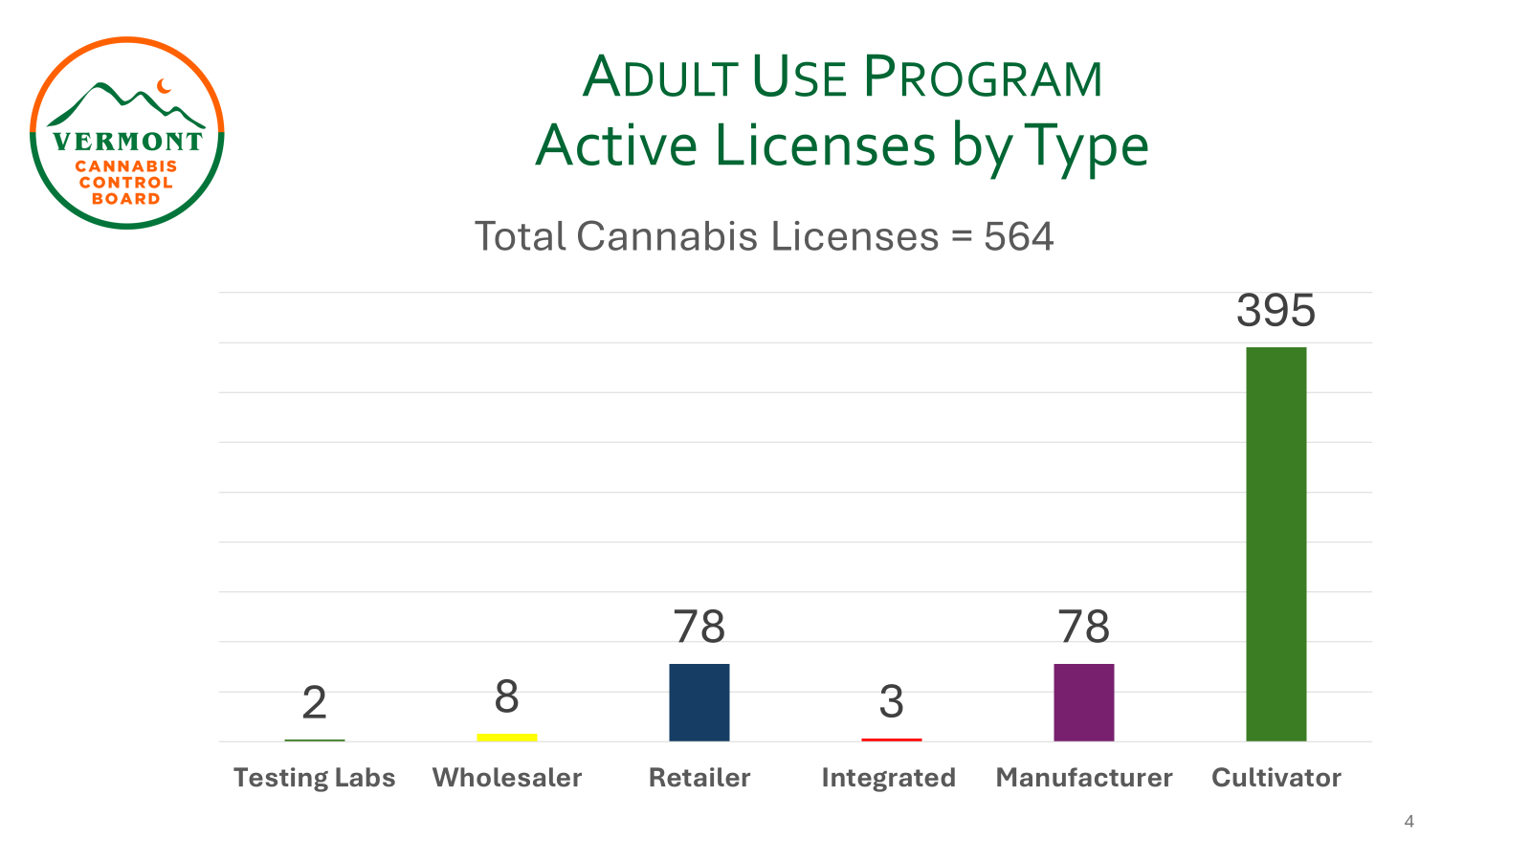
Market Structure
Notes:
Legislature set a goal to move as much of the illicit market into the regulated market as possible that meant
legacy/small growers were prioritized - Also CCB was allowed to reduce some the regulatory burden for small cultivators
Small cultivators are considered farming by statute – which is important from a land use planning perspective in Vermont
And, in consideration of the environmental impact and the agricultural season in Vermont – among the small growers, outdoor cultivation licenses were prioritized
Results in a market structure in which the majority of cannabis in Vermont (at the moment) is
grown outdoor – roughly 70% of our cultivators are outdoor
Roughly 30% of our outdoor cultivators are Tier 1 small cultivators (upto 1000sqft or 125 plants)
Is likely that the majority of cannabis flower will be to be harvested between September and October, and just one harvest this year

Slide 24
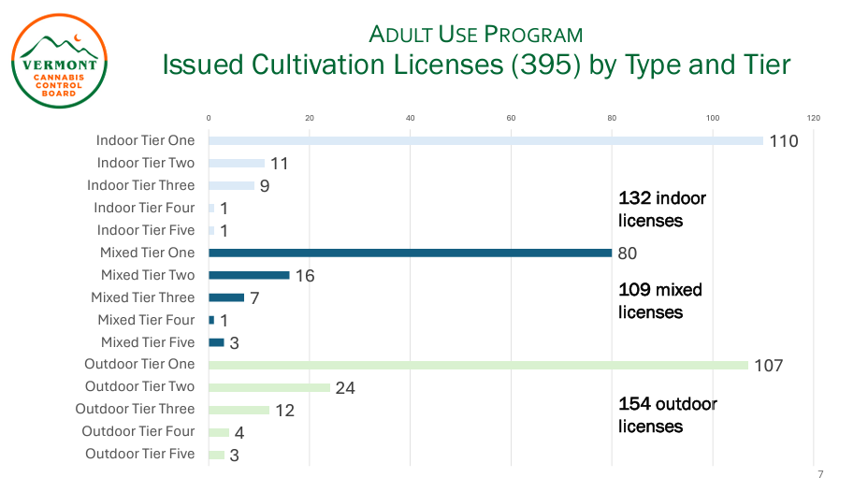
Market Structure
Notes:
Legislature set a goal to move as much of the illicit market into the regulated market as possible that meant
legacy/small growers were prioritized - Also CCB was allowed to reduce some the regulatory burden for small cultivators
Small cultivators are considered farming by statute – which is important from a land use planning perspective in Vermont
And, in consideration of the environmental impact and the agricultural season in Vermont – among the small growers, outdoor cultivation licenses were prioritized
Results in a market structure in which the majority of cannabis in Vermont (at the moment) is
grown outdoor – roughly 70% of our cultivators are outdoor
Roughly 30% of our outdoor cultivators are Tier 1 small cultivators (upto 1000sqft or 125 plants)
Is likely that the majority of cannabis flower will be to be harvested between September and October, and just one harvest this year

Slide 25
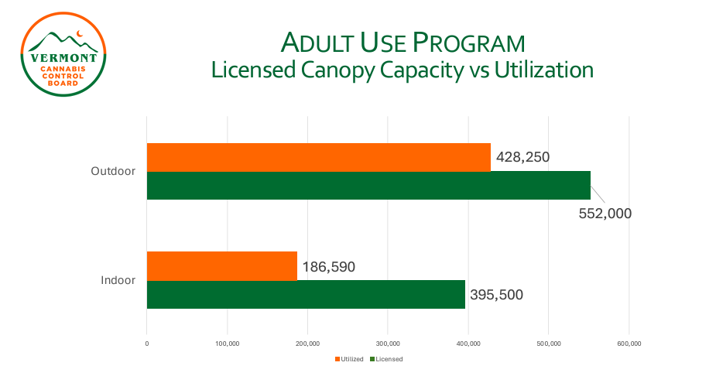
Market Structure
Notes:
Legislature set a goal to move as much of the illicit market into the regulated market as possible that meant
legacy/small growers were prioritized - Also CCB was allowed to reduce some the regulatory burden for small cultivators
Small cultivators are considered farming by statute – which is important from a land use planning perspective in Vermont
And, in consideration of the environmental impact and the agricultural season in Vermont – among the small growers, outdoor cultivation licenses were prioritized
Results in a market structure in which the majority of cannabis in Vermont (at the moment) is
grown outdoor – roughly 70% of our cultivators are outdoor
Roughly 30% of our outdoor cultivators are Tier 1 small cultivators (upto 1000sqft or 125 plants)
Is likely that the majority of cannabis flower will be to be harvested between September and October, and just one harvest this year

Slide 26
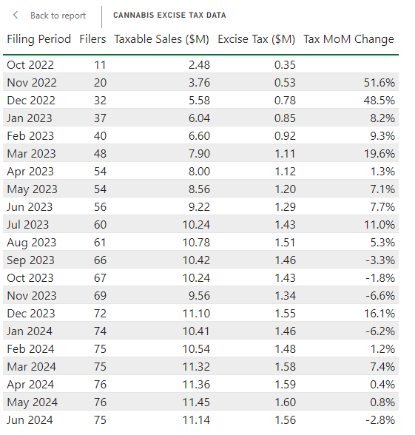
Market Structure
Taxable Sales (Actual)
FY23 – 58.14 M
FY24 – 128.56 M
Taxes (Excise / Sales)
FY23 – 8.14M / 3.49M
FY24 – 17.99M / 7.71M
JFO Updated Forecast
FY25 – 158.57M
FY26 – 171.43M
Notes:
Legislature set a goal to move as much of the illicit market into the regulated market as possible that meant
legacy/small growers were prioritized - Also CCB was allowed to reduce some the regulatory burden for small cultivators
Small cultivators are considered farming by statute – which is important from a land use planning perspective in Vermont
And, in consideration of the environmental impact and the agricultural season in Vermont – among the small growers, outdoor cultivation licenses were prioritized
Results in a market structure in which the majority of cannabis in Vermont (at the moment) is
grown outdoor – roughly 70% of our cultivators are outdoor
Roughly 30% of our outdoor cultivators are Tier 1 small cultivators (upto 1000sqft or 125 plants)
Is likely that the majority of cannabis flower will be to be harvested between September and October, and just one harvest this year

Slide 27
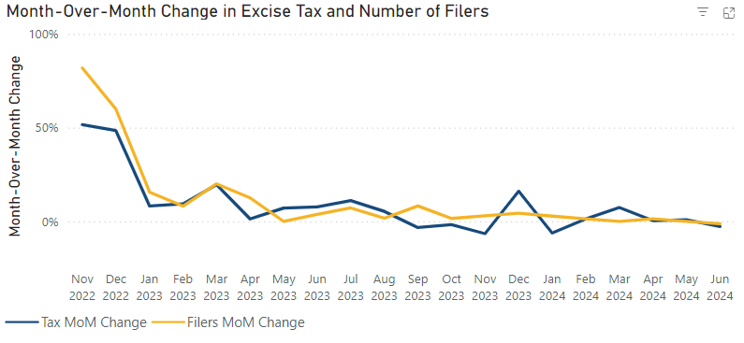
Market Structure
Notes:
Legislature set a goal to move as much of the illicit market into the regulated market as possible that meant
legacy/small growers were prioritized - Also CCB was allowed to reduce some the regulatory burden for small cultivators
Small cultivators are considered farming by statute – which is important from a land use planning perspective in Vermont
And, in consideration of the environmental impact and the agricultural season in Vermont – among the small growers, outdoor cultivation licenses were prioritized
Results in a market structure in which the majority of cannabis in Vermont (at the moment) is
grown outdoor – roughly 70% of our cultivators are outdoor
Roughly 30% of our outdoor cultivators are Tier 1 small cultivators (upto 1000sqft or 125 plants)
Is likely that the majority of cannabis flower will be to be harvested between September and October, and just one harvest this year

Slide 28
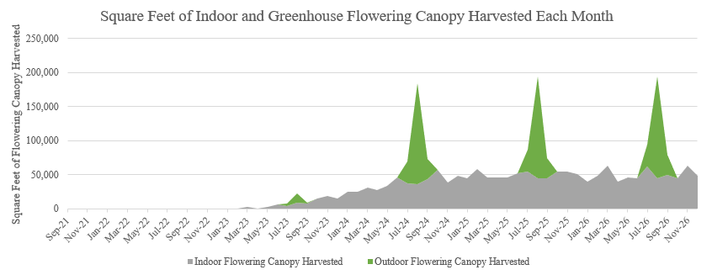
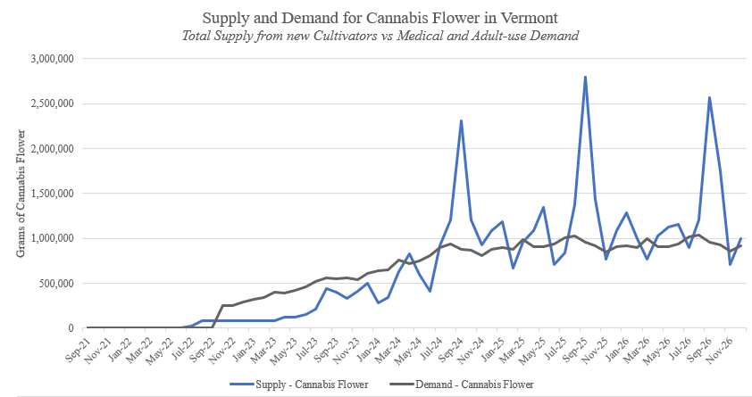
Market Structure
Notes:
Legislature set a goal to move as much of the illicit market into the regulated market as possible that meant
legacy/small growers were prioritized - Also CCB was allowed to reduce some the regulatory burden for small cultivators
Small cultivators are considered farming by statute – which is important from a land use planning perspective in Vermont
And, in consideration of the environmental impact and the agricultural season in Vermont – among the small growers, outdoor cultivation licenses were prioritized
Results in a market structure in which the majority of cannabis in Vermont (at the moment) is
grown outdoor – roughly 70% of our cultivators are outdoor
Roughly 30% of our outdoor cultivators are Tier 1 small cultivators (upto 1000sqft or 125 plants)
Is likely that the majority of cannabis flower will be to be harvested between September and October, and just one harvest this year

Slide 29
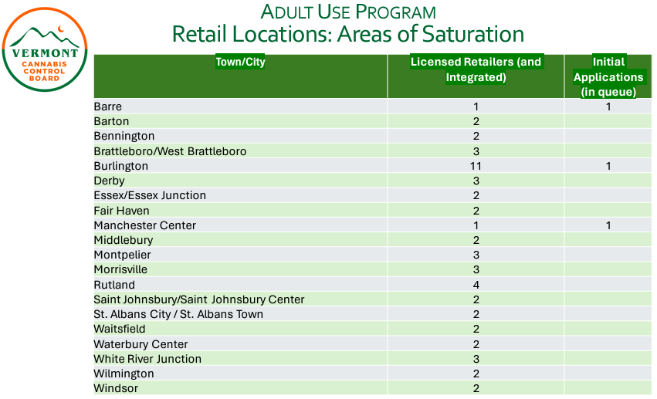
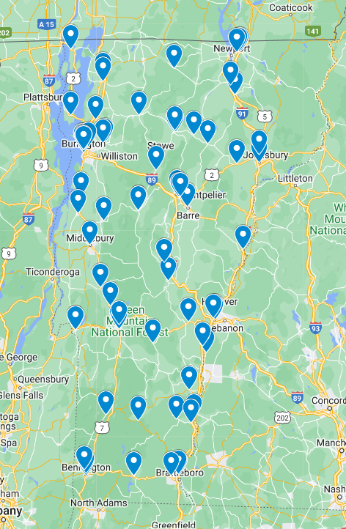
Market Structure
Notes:
Legislature set a goal to move as much of the illicit market into the regulated market as possible that meant
legacy/small growers were prioritized - Also CCB was allowed to reduce some the regulatory burden for small cultivators
Small cultivators are considered farming by statute – which is important from a land use planning perspective in Vermont
And, in consideration of the environmental impact and the agricultural season in Vermont – among the small growers, outdoor cultivation licenses were prioritized
Results in a market structure in which the majority of cannabis in Vermont (at the moment) is
grown outdoor – roughly 70% of our cultivators are outdoor
Roughly 30% of our outdoor cultivators are Tier 1 small cultivators (upto 1000sqft or 125 plants)
Is likely that the majority of cannabis flower will be to be harvested between September and October, and just one harvest this year

Slide 30
Market Structure
Market Saturation
-Close larger tiers of cultivation
-Tier expansion and relegation
-Increase market capture
-License moratorium
-Limit application window
-Retail siting requirements
Notes:
Legislature set a goal to move as much of the illicit market into the regulated market as possible that meant
legacy/small growers were prioritized - Also CCB was allowed to reduce some the regulatory burden for small cultivators
Small cultivators are considered farming by statute – which is important from a land use planning perspective in Vermont
And, in consideration of the environmental impact and the agricultural season in Vermont – among the small growers, outdoor cultivation licenses were prioritized
Results in a market structure in which the majority of cannabis in Vermont (at the moment) is
grown outdoor – roughly 70% of our cultivators are outdoor
Roughly 30% of our outdoor cultivators are Tier 1 small cultivators (upto 1000sqft or 125 plants)
Is likely that the majority of cannabis flower will be to be harvested between September and October, and just one harvest this year

Slide 31
Questions

